Slide 1
Computer Graphics III
Introduction
Jaroslav Křivánek, MFF UK
Jaroslav.Krivanek@mff.cuni.cz

Slide 2
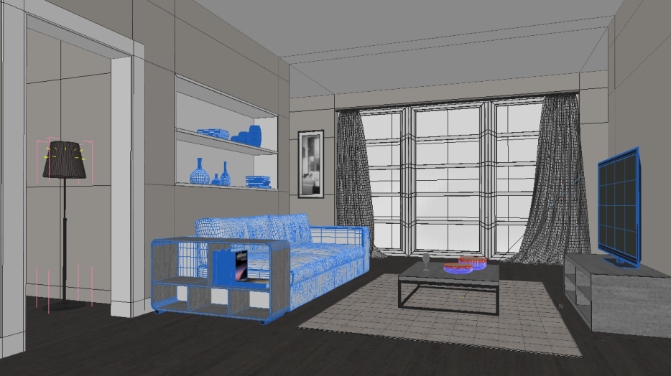
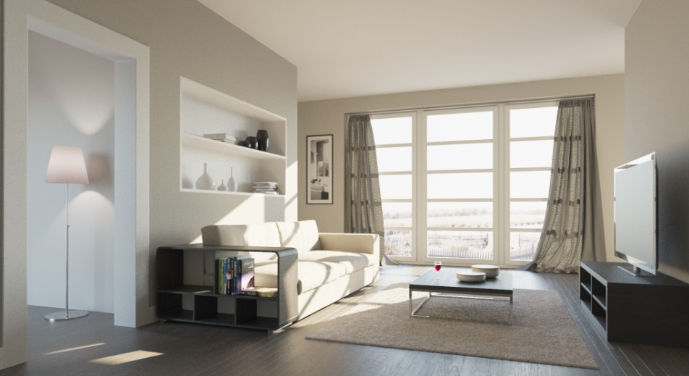
Image synthesis (rendering)
Given a scene description
Create an image
(that looks like reality)

Slide 3
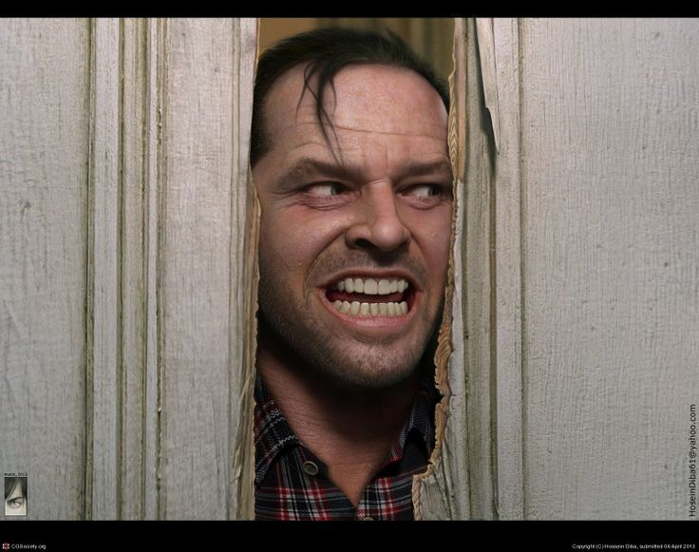
Copyright © Hossein Diba

Slide 4

Image created by Bertrand Benoit
Rendered in Corona Renderer

Slide 5

Image created by Jeff Patton
Rendered in Corona Renderer

Slide 6
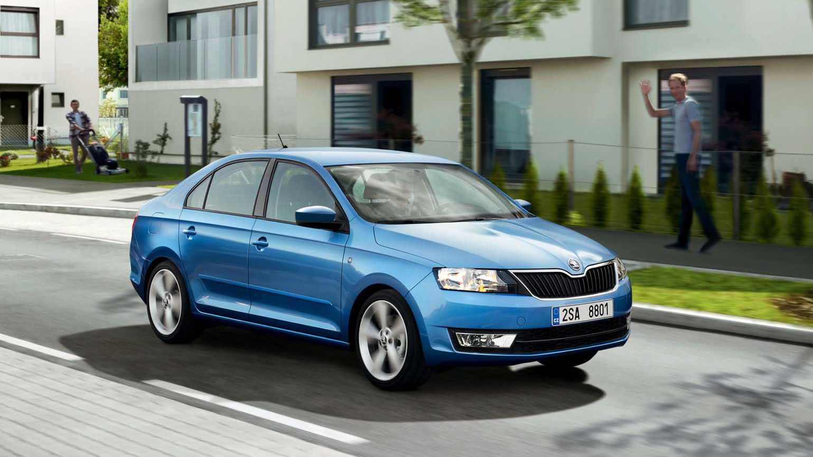
ŠKODA Rapid Catalogue

Slide 7



Slide 8
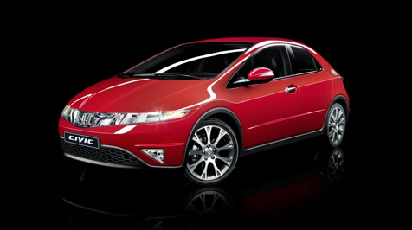
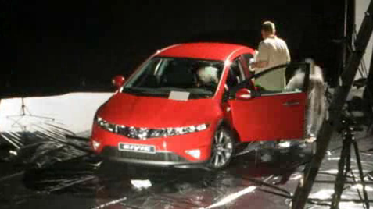
Fake or real?
Images courtesy
Dudek Digital Imaging

Slide 9
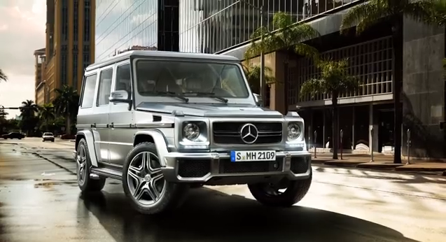
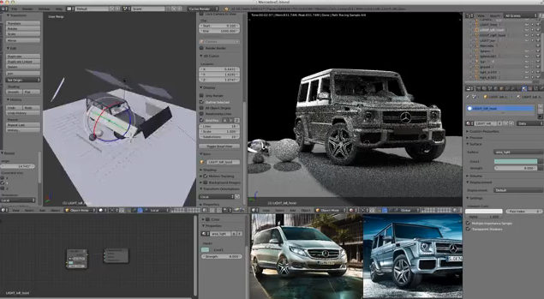
Fake or real?
Images courtesy
Maciek Ptaszynski

Slide 10
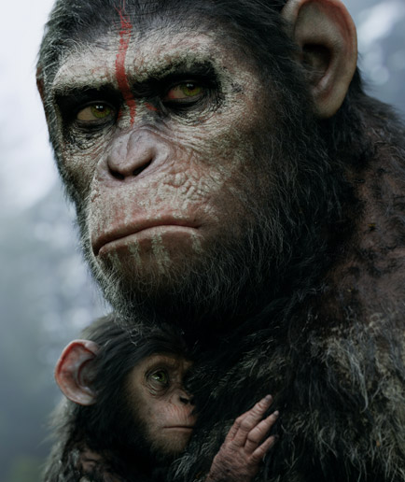
Image created by Weta Digital
© 20th Century Fox

Slide 11


Slide 12
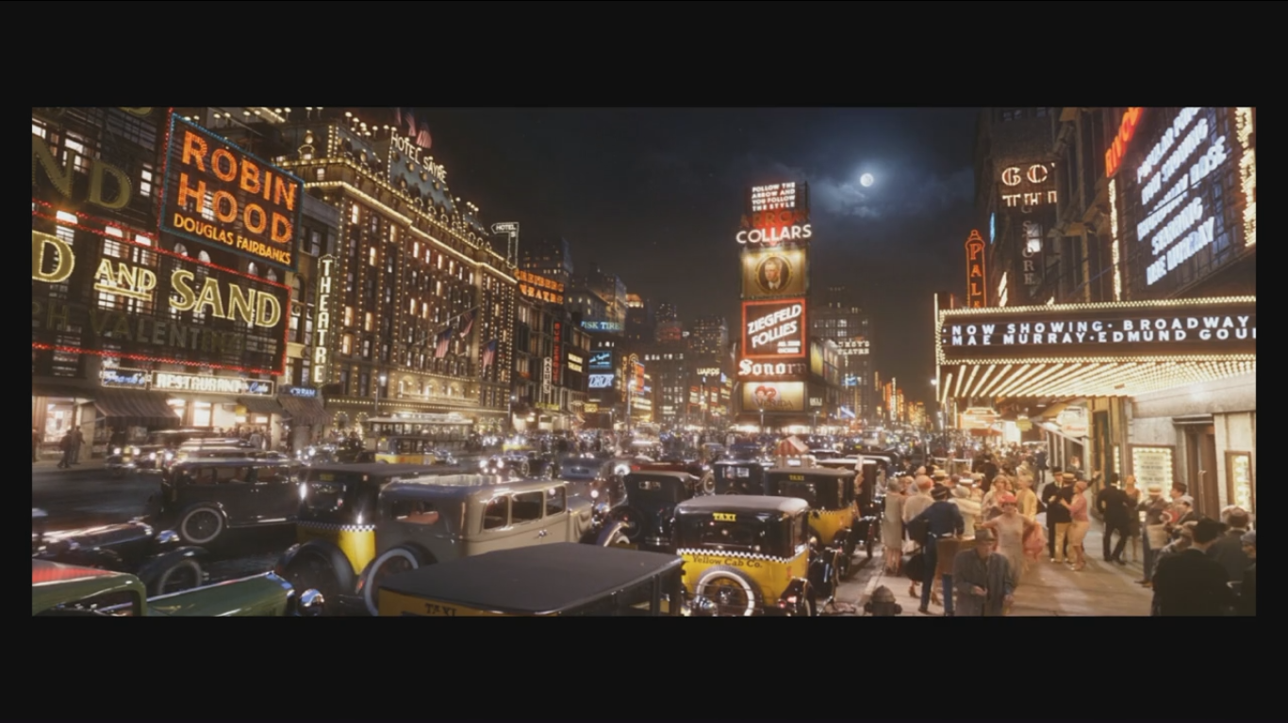
vimeo >> “The Great Gatsby VFX”

Slide 13
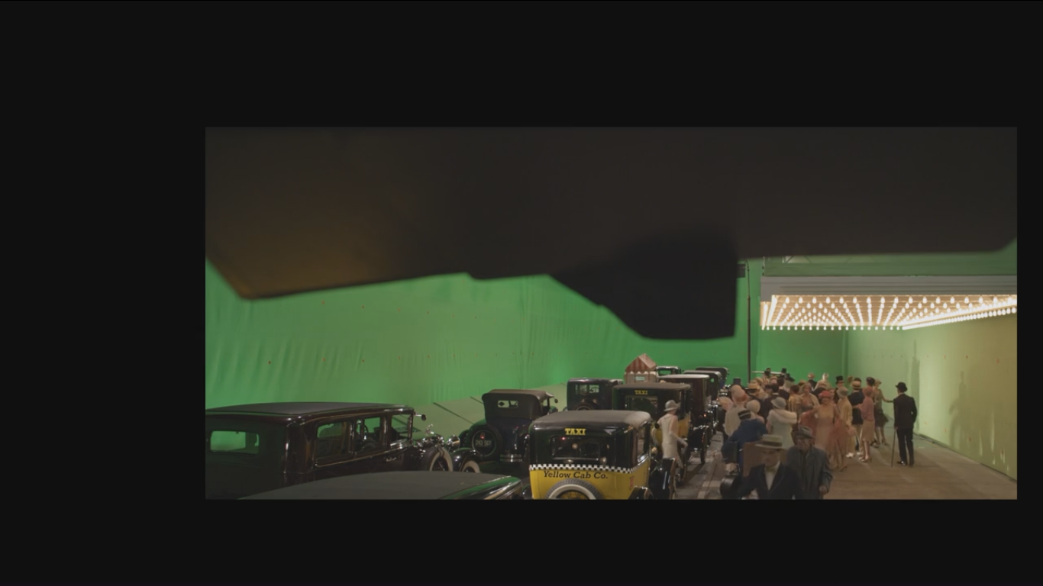
vimeo >> “The Great Gatsby VFX”

Slide 14




Path tracing (Arnold renderer)
Alice in the Wonderland, 2010
Images courtesy of Walt Disney Pictures

Slide 15
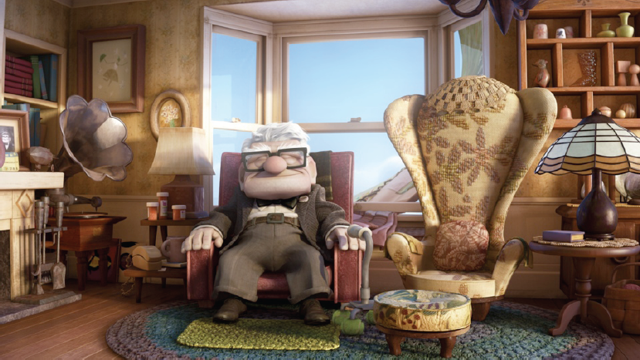
Point-based global illumination:
“Up”
© Pixar Animation Studios
Image credit: Per Christensen

Slide 16
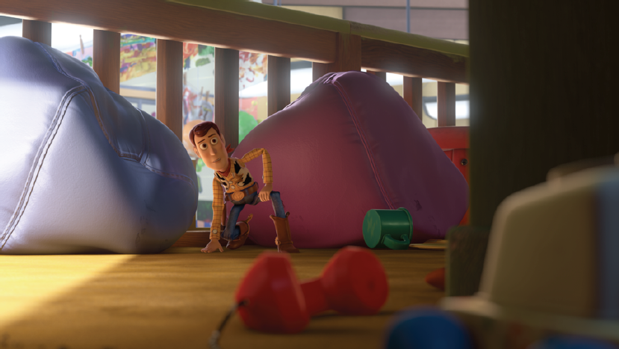
Point-based global illumination:
“Toy Story 3”
Algorithm: POINT-BASED GI
© Pixar Animation Studios
Image credit: Per Christensen

Slide 17


Slide 18
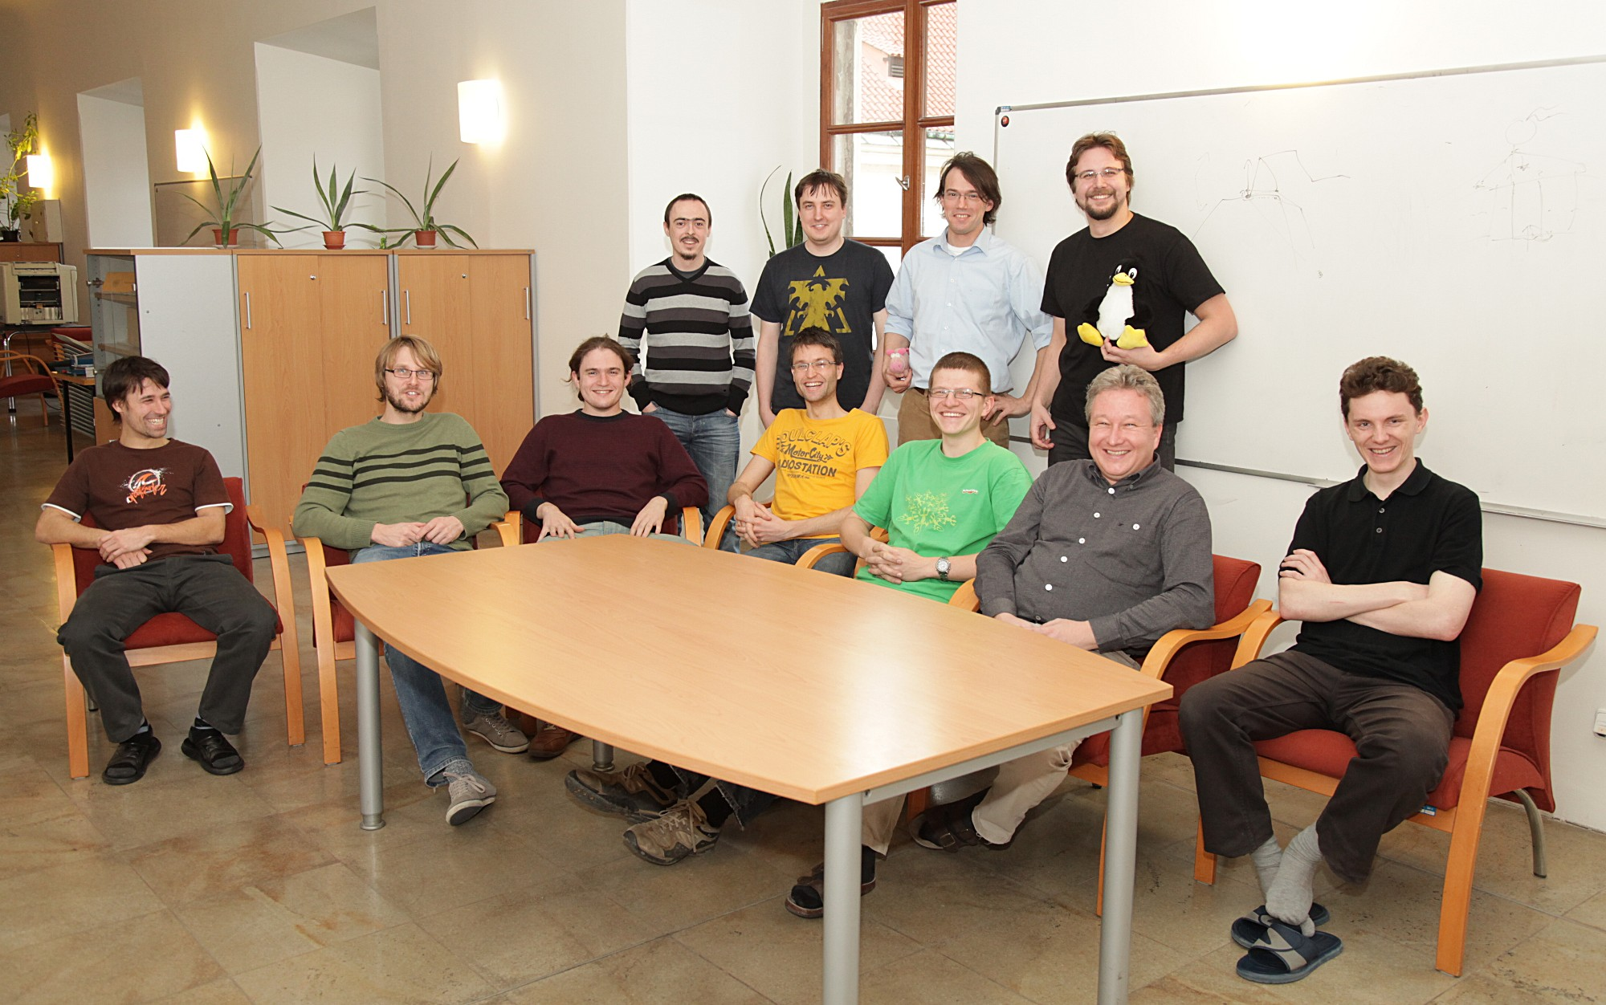





Computer Graphics Group

Slide 19
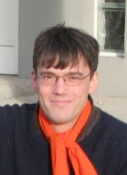


Graphics@CUNI – Faculty
Jarda Křivánek
Alex Wilkie
Pepča Pelikán

Slide 20
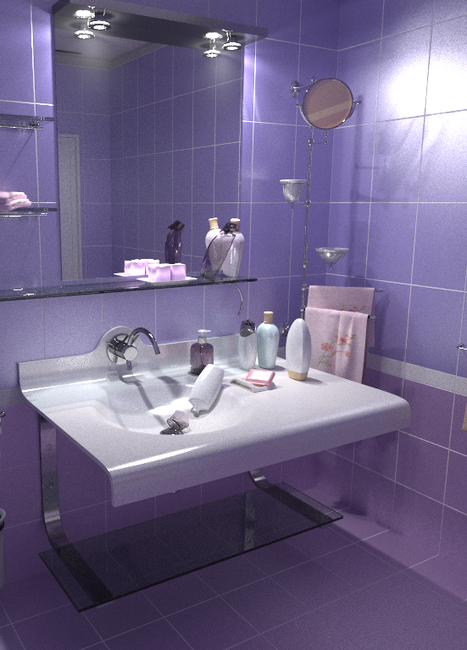
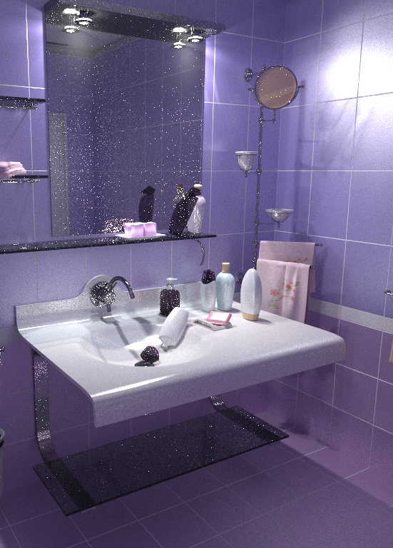
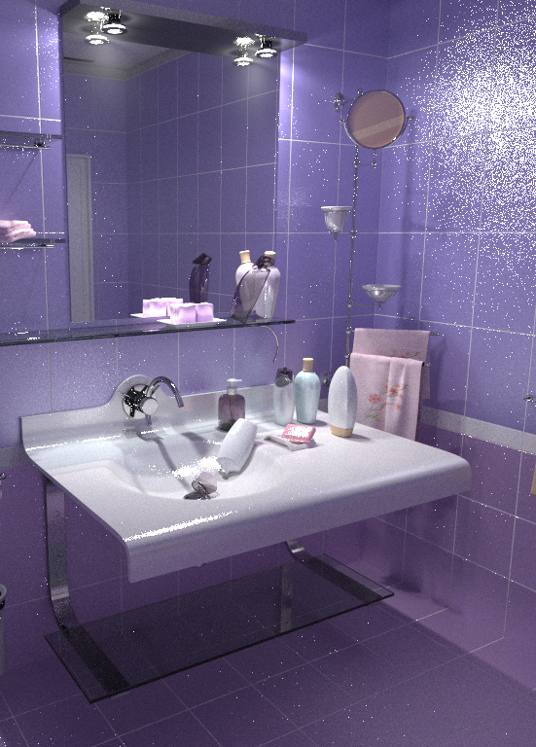
Vertex Connection & Merging (VCM)
SIGGRAPH Asia 2012
VCM (new)
BPT
PPM

Slide 21
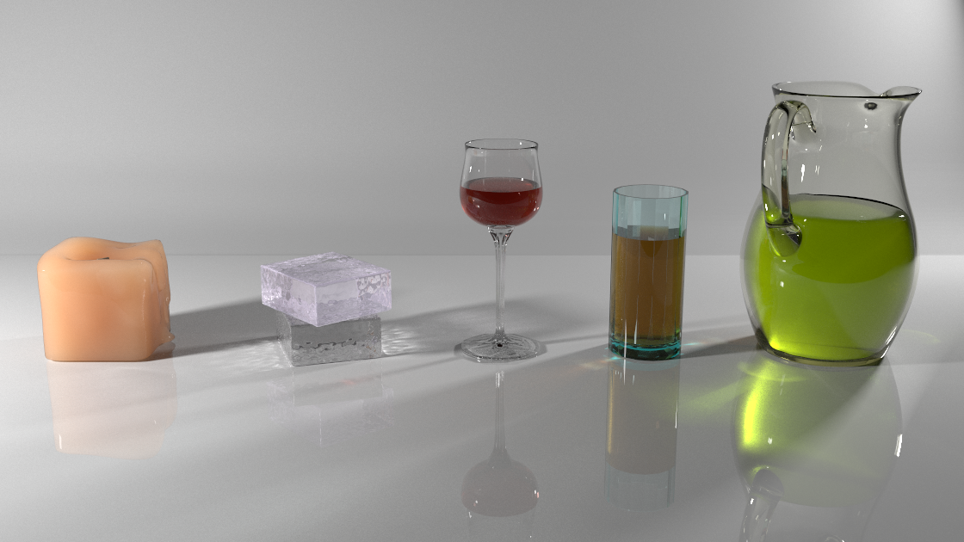
Robust rendering of volumetric media
SIGGRAPH 2014

Slide 22




Our work in production

Slide 23


Slide 24
Image synthesis – A gentle intro

Slide 25
Image synthesis (rendering)
Given a scene description
Create an image
(that looks like reality)

Slide 26
Scene description
Geometry
  Where is which object and what shape does it have?
  Usually represented by triangular meshes
  Accessed via ray casting
Surface reflectance
  Surface color, glossiness, transparency, etc.
  Mathematical model: the BRDF
Light sources
  Spatial and directional distribution of emitted light
  Radiometric terms are used to describe this
Camera (sensor)
  Position, orientation, type (perspective, spherical), etc.
  Mathematical model: the Measurement Equation

Slide 27
Application of realistic image synthesis
Movie production
Entertainment, games
Industrial design
Architecture
Virtual showrooms
On-line commerce
Cultural heritage
Virtual and augmented reality

Slide 28

Light transport simulation
emission
propagation
interaction

Slide 29
Light transport simulation
Rendering = sum-up
contributions of all light
transport paths

Slide 30

What’s in the image?
Image courtesy Eugene d’Eon

Slide 31
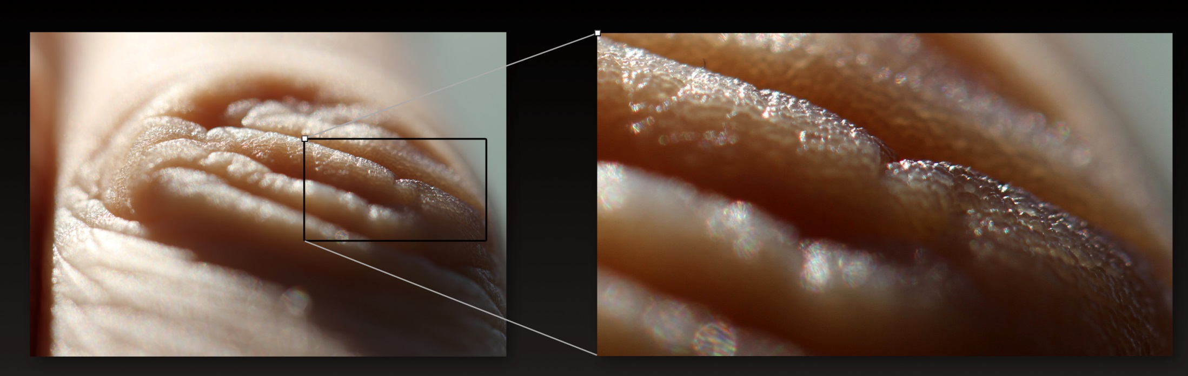
What’s in the image?
Image courtesy Eugene d’Eon

Slide 32
Why does skin look the way it does?

Slide 33
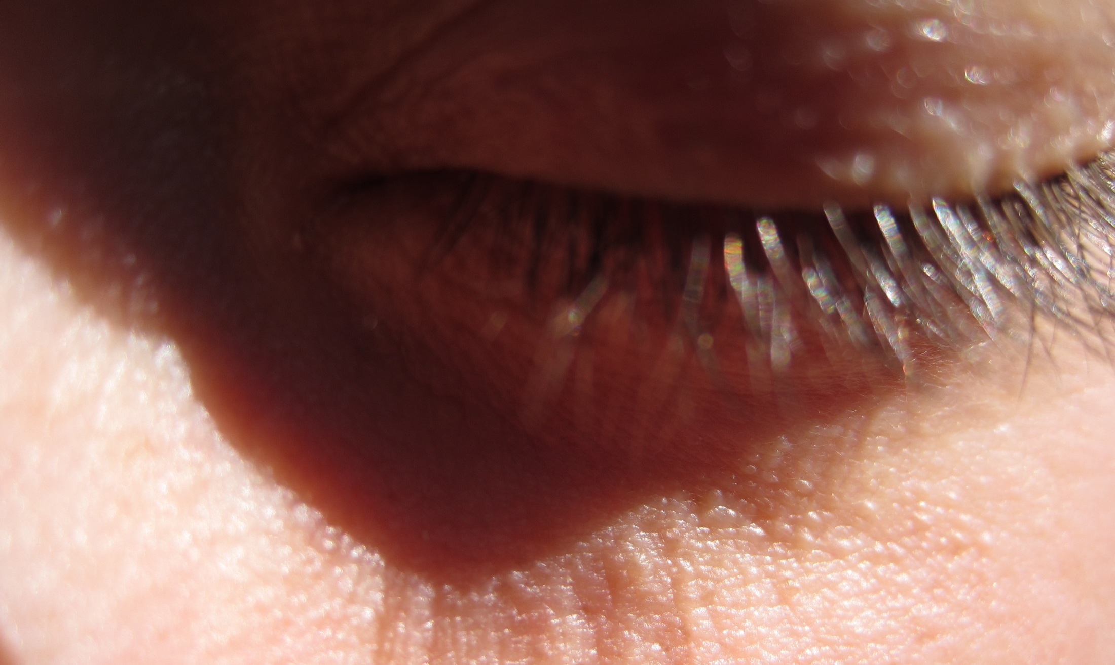
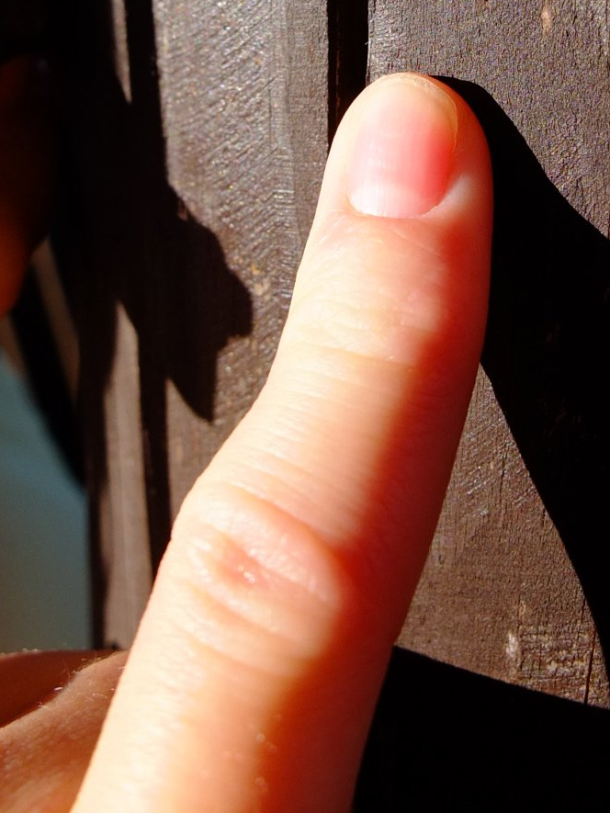
Subsurface scattering effects on skin

Slide 34
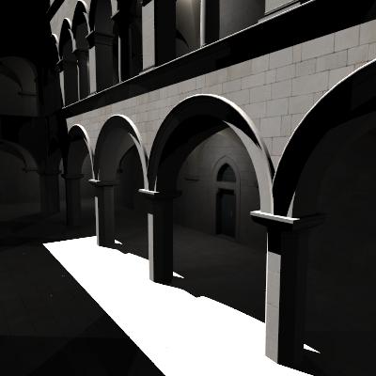
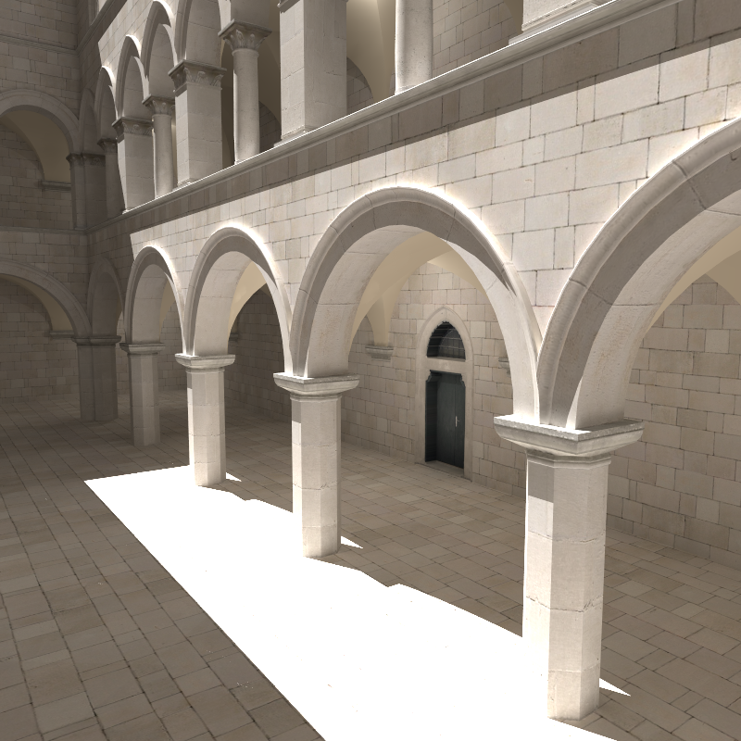
Global illumination – GI
Direct illumination
Global =
direct +
indirect
34

Slide 35
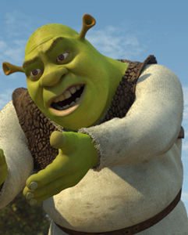
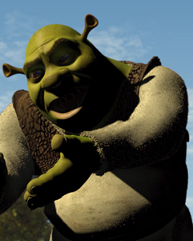
Globální osvětlení
Direct illumination
  Light reflects only once on its way from the source to the camera
Global illumination
  Global = Direct + Indirect
  Light transport between surfaces in the scene
  Multiple reflections/refractions
Images © PDI/Dreamworks

Slide 36
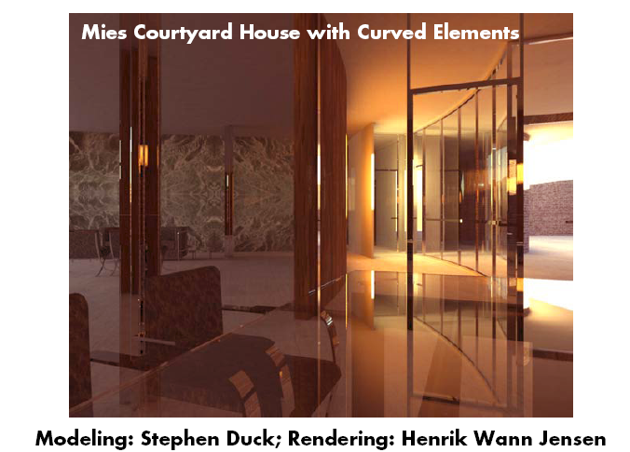
Global illumination effects
Ideal (mirror) reflection / refraction
Color bleeding
Caustics

Slide 37
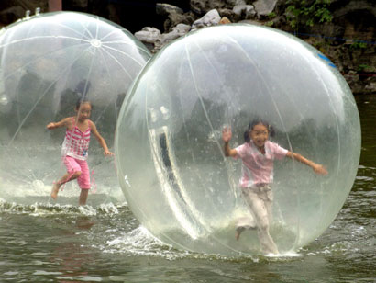
Ideal (mirror) reflection/refraction
Glass, mirror, water surface
E.g. the image we see on a water surface is due to light in a completely different part of the scene (bottom, environment, sky, sun)

Slide 38
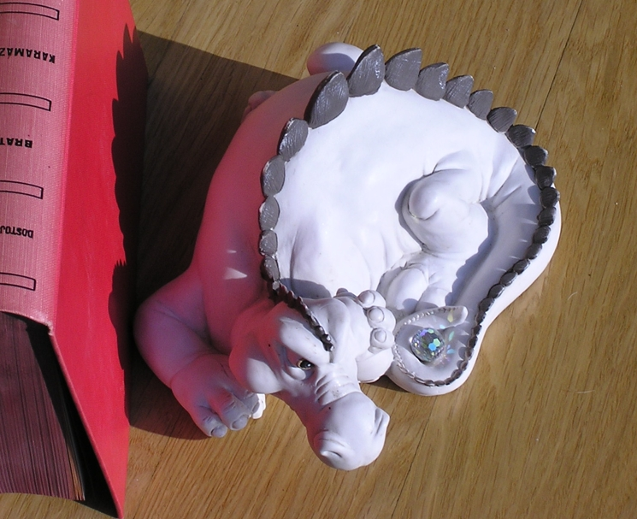
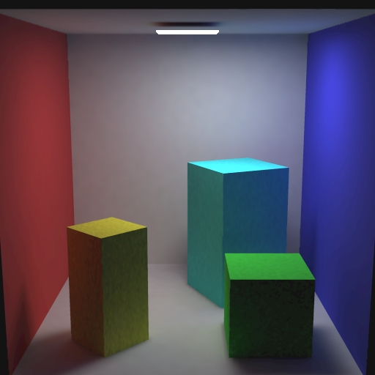
Color bleeding
Light reflected from one diffuse surface onto another
Important for understanding of the spatial relationships of objects in a given scene (this happens subconsciously)

Slide 39
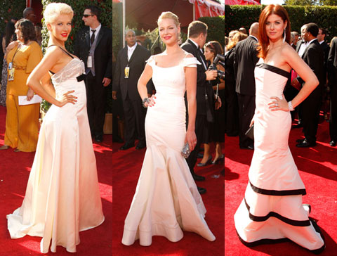
Color bleeding
Image courtesy Michael Bunnell
39

Slide 40
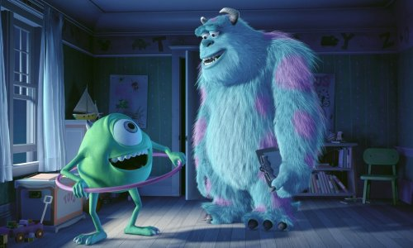
“Manual” global illumination
Monsters Inc., 2001
© Pixar Animation Studios
Manually placed light sources as a proxy for GI
  E.g. The cyan-ish tint on Mike Wasowski “reflected” from Sulley’s belly
Was used before full GI simulation started to be feasible

Slide 41
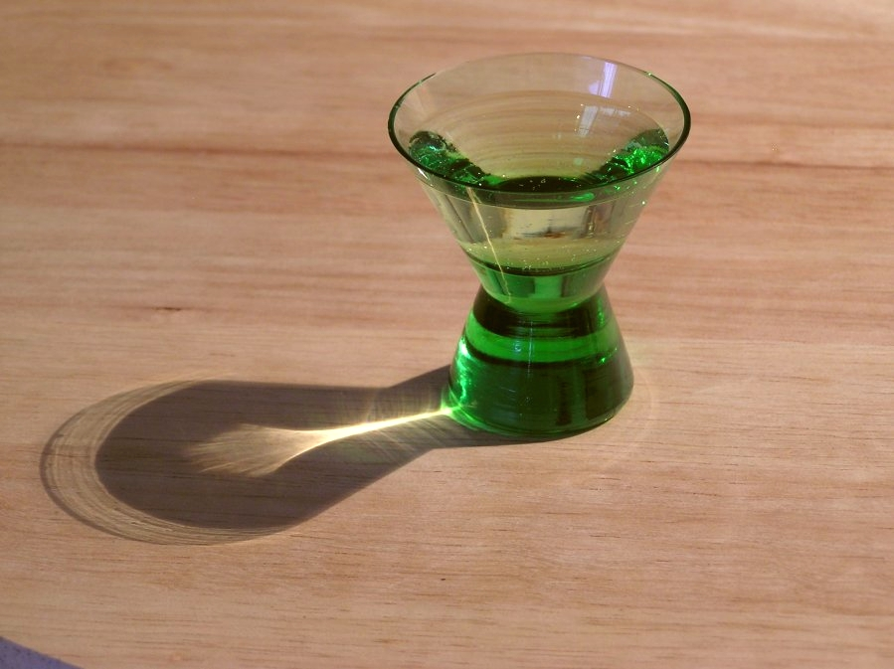
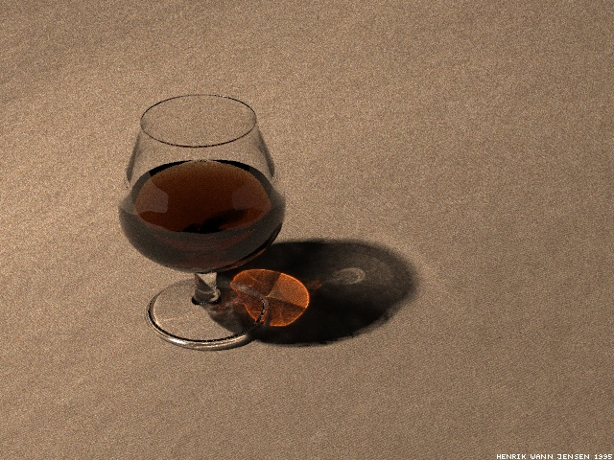
Caustics
Focusing of light as it’s reflected or refracted, leading to local increase of intensity
Photograph
Simulation using photon maps

Slide 42
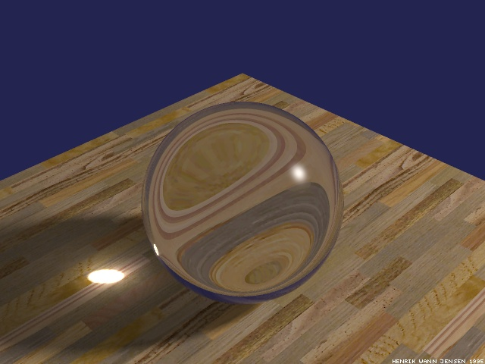
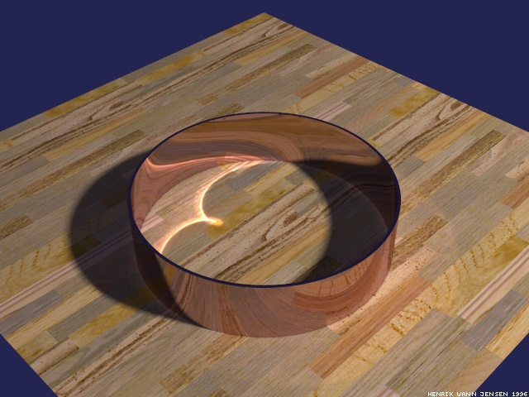
Caustics
In physics or in computer vision, a caustic refers to a singularity of light intensity (infinite density of light energy)

Slide 43
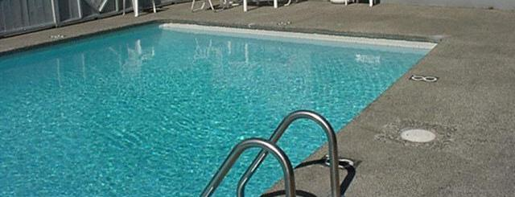
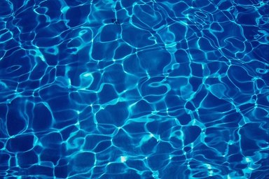
What do we see when we look at a surface of a swimming pool?
Reflections + refractions on
water surface
Caustics at the bottom

Slide 44
Caustics under water surface
High „concentration“ of photons – high light intensity
Low intensity

Slide 45
Realistic image synthesis: Ingredients
Describe the “amount of light” in space – radiometry
Describe light interaction with surfaces – BRDF
Describe equilibrium light distribution – rendering equation (RE)
Image rendering = numerical solution of the RE
  Find the light distribution in a given scene that fulfils
    The rendering equation
    The „boundary conditions “ = i.e. the scene model
  Methods
    Finite elements (radiosity) – obsolete
    Monte Carlo (stochastic ray tracing) – prevalent

Slide 46
Light

Slide 47
Realistic image synthesis
How much light?

Slide 48
Different approaches to rendering
Phenomenological
  Traditional, “old” computer graphics
  E.g. Phong shading model, colors between 0 and 1, etc.
Physically-based
  Based on a proper mathematical formulation
  Rendering algorithms = numerical methods for solving the rendering equation
  Radiance values between 0 and infinity

Slide 49
Mathematical model
Image synthesis (rendering) = light transport simulation
We need a mathematical model for light
Formulation of the model = choice of level of detail
  No need to model the behavior of every single photon
  Need simplifying assumptions

Slide 50
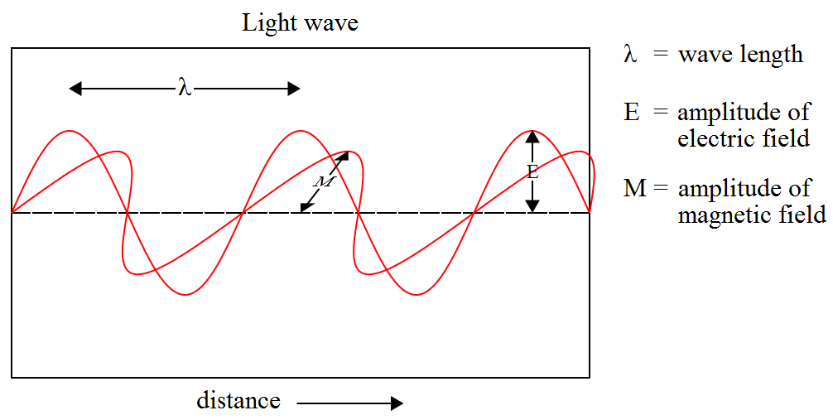
Light
EM radiation (an EM wave propagating through space)
Image: Wikipedia

Slide 51
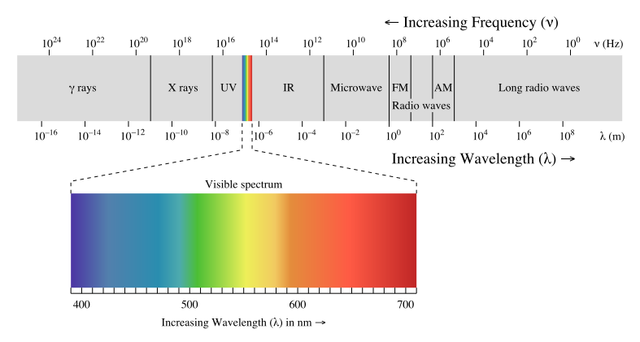
Light
Frequency of oscillations => wavelength => perceived color
Image: Wikipedia

Slide 52
Various kinds of optics
Geometry (ray) optics
  Most useful for rendering
  Describes bulk, macroscopic effects of light
  It is not a complete theory (Does not describe all observed phenomena, such as diffraction, interference etc.)
Wave optics (light = E-M wave)
  Important when describing interaction of light with objects of size on par with the light wavelength
  Interference (soap bubbles), diffraction, dispersion
Quantum optics (light = photons)
  Necessary to describe interaction of light with atoms

Slide 53
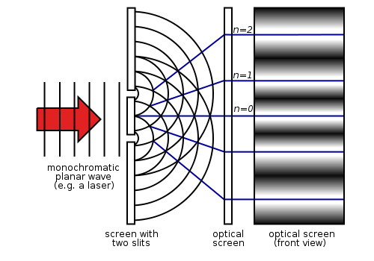
Effects of the wave nature of light
Interference
  Young experiment, a.k.a. double-slit experiment

Slide 54
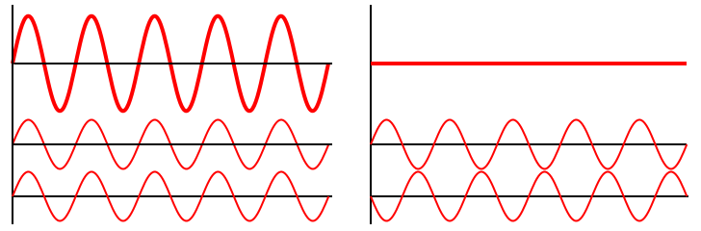
Effects of the wave nature of light
Interference
  Causes iridescence (structural coloration)
Constructive
Destructive
Img: Wikipedia

Slide 55
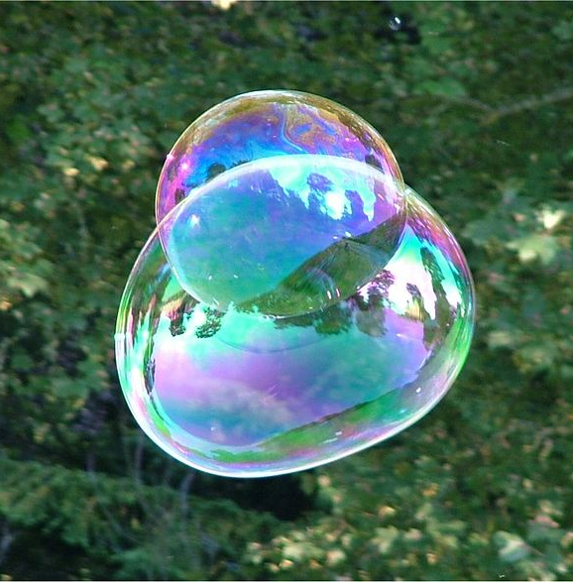
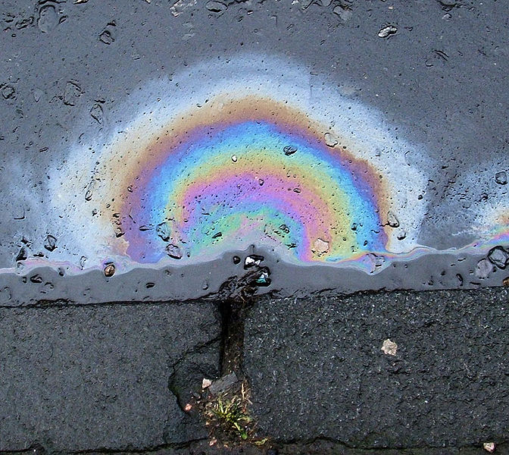
Iridescence
Thin-film interference
Color changes with the observation angle
Img: http://en.wikipedia.org/wiki/Iridescence

Slide 56
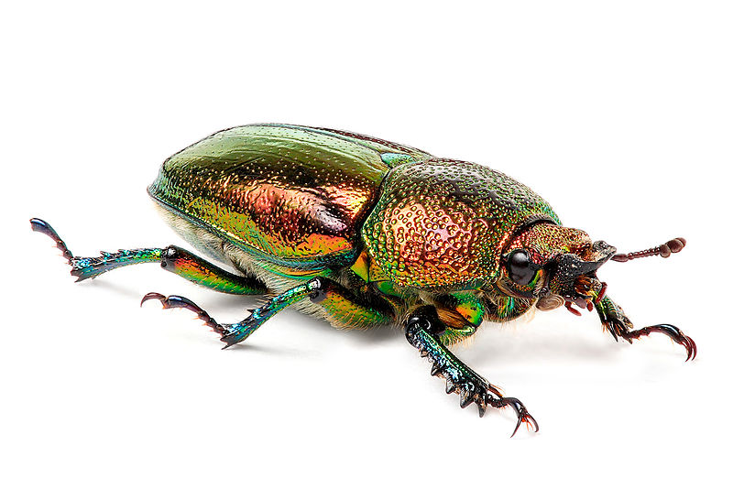
Iridescence – Structural coloration
Biological tissues can have layers causing interferences
Img: http://en.wikipedia.org/wiki/Iridescence

Slide 57
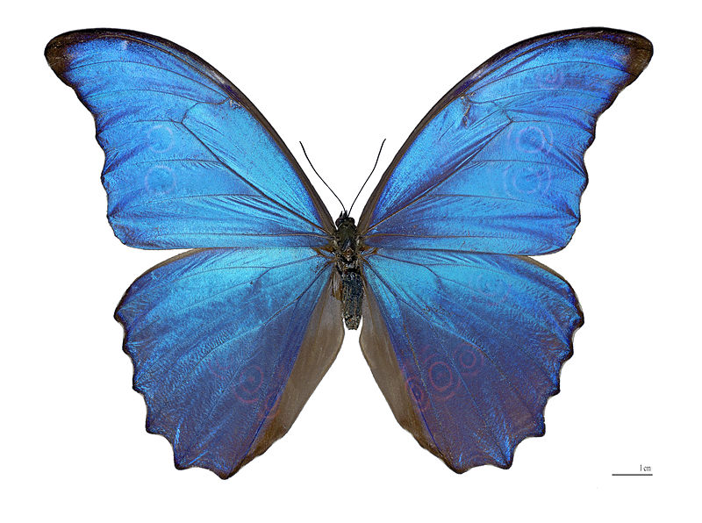
Iridescence – Structural coloration
Img: http://en.wikipedia.org/wiki/Iridescence

Slide 58
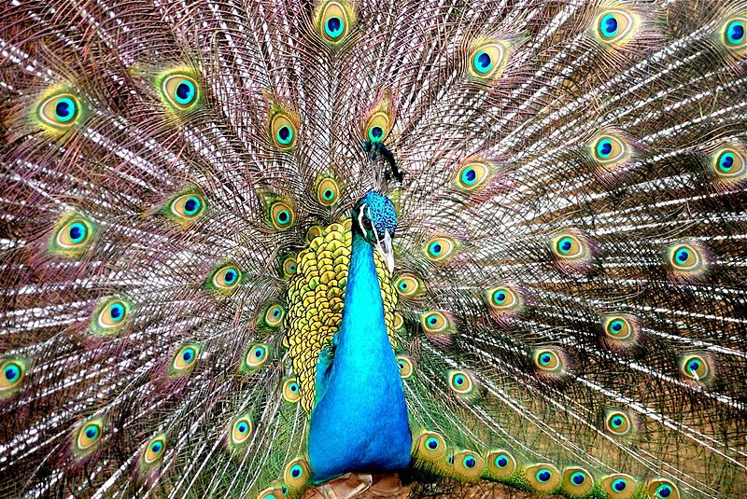
Iridescence – Structural coloration
Img: http://en.wikipedia.org/wiki/Iridescence

Slide 59
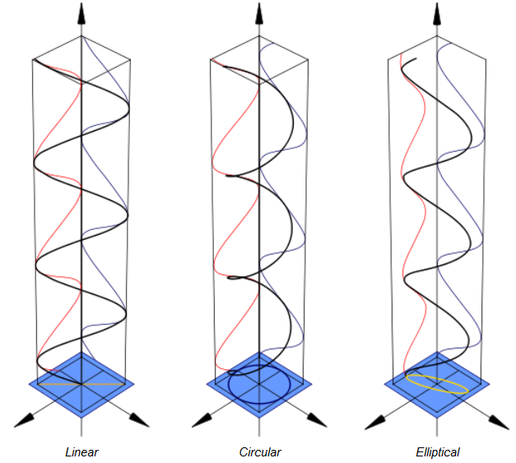
Polarization
Preferential orientation of the E-M waves with respect to the direction of travel
Unpolarized light – many waves with different polarization
More in the “Predictive
rendering” class

Slide 60
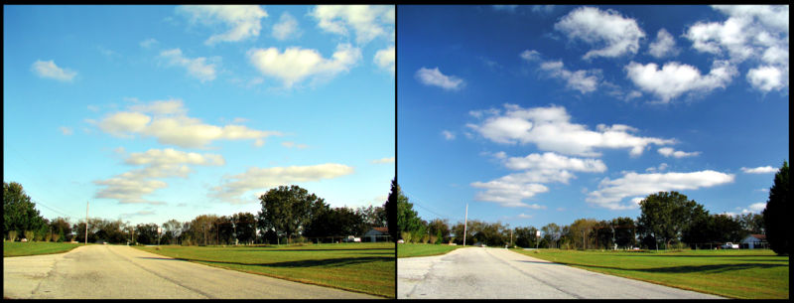
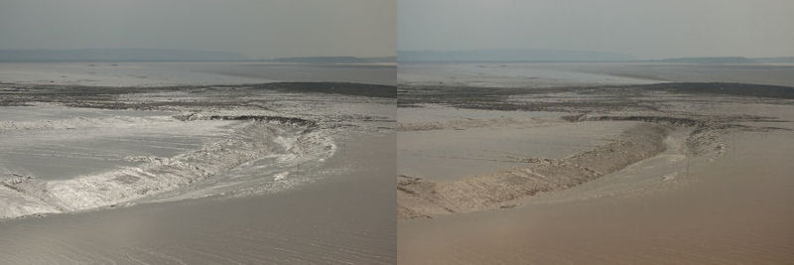
Polarization
Skylight is partially polarized
Specular reflections are polarized

